Slide 1
Enhancing Supply Chain Procurement with AI Technologies
Justin Keeler, Wichita State University
Clinical Associate Professor of Business Analytics
Institute for Supply Management 2024
Heartspring Convention Center
Wichita, Kansas
Thursday, April 25th, 2024

Slide 2

Introduction
Is it AI or NOT?
AI in Supply Chain: LLM or Non LLM
Have you considered the Benefits vs. Challenges in supply chain procurement?
A framework to consider for deployment.
Future Trends

Slide 3
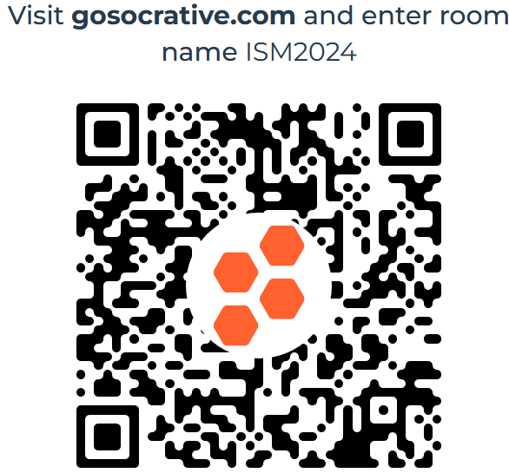
Is it AI or NOT?

Slide 4
AI in Supply Chain: Emergence
What are you seeing as AI's role in supply chain management?
Distinction between LLM-based and non-LLM AI technologies.

Slide 5
10 Usages of LLM Models in Supply Chain Procurement
Automated responses to supplier inquiries
Document analysis and summarization for faster decision-making
Translation services for global communication
Predictive analytics for demand forecasting
Real-time advice for negotiation strategies
Automated compliance monitoring
Enhanced reporting on procurement metrics
Risk assessment and mitigation suggestions
Supplier selection and evaluation assistance
Training and onboarding through interactive chat interfaces

Slide 6
Benefits of LLM-Based AI Deployment
Enhanced Efficiency
Improved Decision Making
Scalability
Cost Reduction
Accessibility
Language and Communication Enhancement

Slide 7
Challenges of LLM-Based AI Deployment
Data Privacy and Security
Bias and Fairness
Dependence on Data Quality
Complexity in Customization
Ongoing Training and Updating

Slide 8
10 Usages of Non-LLM AI Models in Supply Chain Procurement
Robotic Process Automation (RPA) for data entry tasks
Internet of Things (IoT) for inventory and asset tracking
Machine learning for complex data analysis and pattern recognition
Optical Character Recognition (OCR) for digitizing physical documents
Blockchain for secure and transparent transactions
Data visualization tools for strategic insight gathering
Neural networks for route and logistics optimization
Predictive maintenance using IoT sensors
Virtual reality for training in warehouse management
Advanced analytics for supplier performance evaluation

Slide 9
Benefits of Non-LLM AI Deployment
Task-Specific Optimization
Reduced Error Rates
Enhanced Data Handling and Analysis
Increased Transparency and Traceability
Innovative Interactions

Slide 10
Challenges of Non-LLM AI Deployment
High Initial Investment
Technical Expertise Requirements
Integration Complexity
Scalability Issues
Regulatory and Compliance Challenges

Slide 11
Benefits of AI in Procurement
Streamlined operations through automation.
Enhanced decision-making from predictive analytics.
Improved supplier relationships and compliance.

Slide 12
A Deployment Strategy
Key steps for successful AI integration.
Focus on needs assessment, technology selection, and training.

Slide 13
Step 1: Identify Procurement Needs
Assess pain points and potential AI benefits.
Determine specific AI applications relevant to your operations.

Slide 14
Step 2: Choose Suitable AI Technologies
Evaluate technology options based on scalability, cost, and compatibility.
Select LLM-based or non-LLM technologies tailored to specific needs.

Slide 15
Step 3: Pilot and Integrate
Conduct pilot tests to gauge technology effectiveness.
Carefully integrate successful AI solutions into existing systems.

Slide 16
Step 4: Train and Adapt
Develop comprehensive training programs for staff.
Encourage feedback and adapt AI tools as needed.

Slide 17
Maintaining AI Systems in Procurement
Regular updates and maintenance for AI systems.
Continuous learning and adaptation to new challenges and opportunities.

Slide 18

Future Trends in AI for Procurement
Emerging technologies and their potential impact.
Preparing for future AI advancements in procurement.

Slide 19

Conclusion
Summary of AI benefits and deployment steps.
Encouragement to embrace AI for competitive advantage.

Slide 20

Some Supply Chain Fun Before Q&A

Slide 21
Q&A

